Slide 1


SALARY PREDICTOR APP
Dinesh K
Batch 11

Slide 2

WHAT THE APP DOES?
Predicts salary based on user inputs like company, job title, location, and rating.
Shows salary trends using charts.
Lets users explore the dataset and download filtered data.
Easy to use and runs in the browser.

Slide 3

HOW IT WORKS?
Loads a CSV file with salary data.
Cleans the column names and handles missing values.
Uses a machine learning model (Linear Regression) to learn patterns.
Takes user inputs and gives a salary prediction instantly.

Slide 4
FEATURES
Sidebar filters for company and employment type.
Tabs for analysis, prediction, and data explorer.
Interactive charts (salary distribution, top companies, etc.).
Clean layout with quick stats and download option.

Slide 5

MODEL DETAILS
Uses a pipeline with preprocessing and regression.
Categorical data is encoded, numeric data passed through.
Model trained on 80% of the data, tested on 20%.
Shows R² score to measure accuracy.

Slide 6
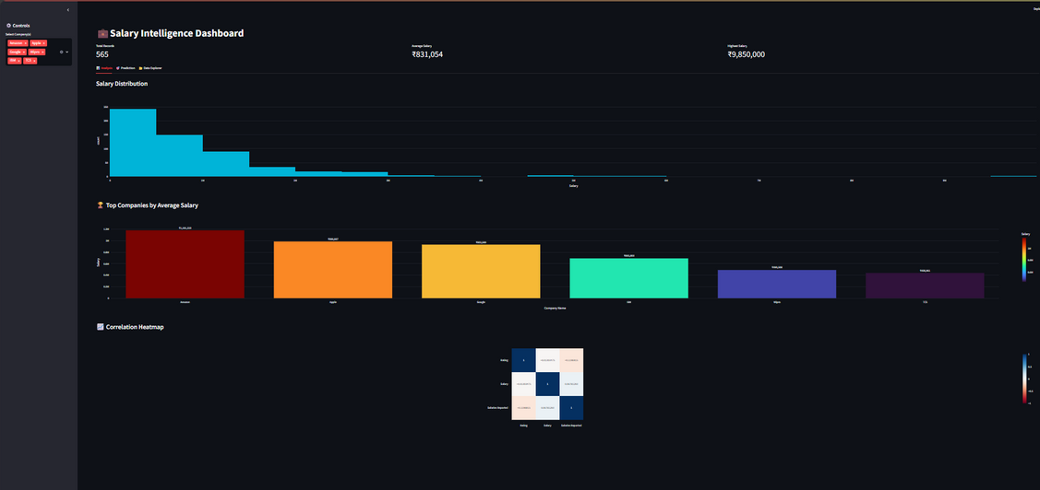
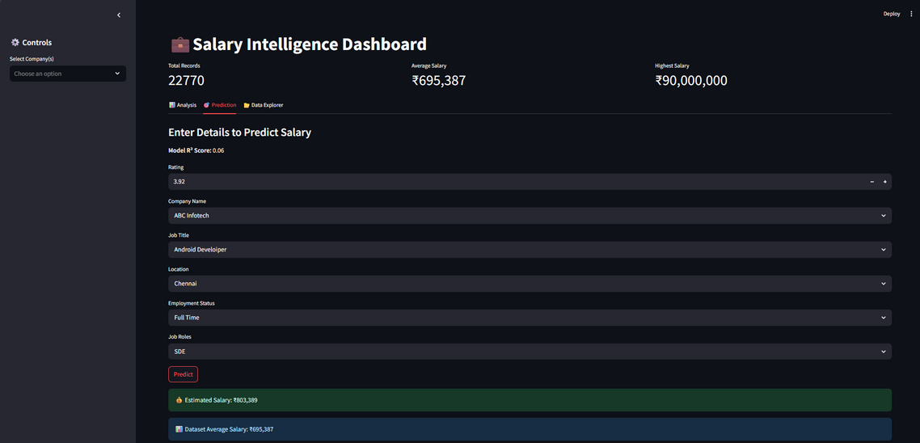
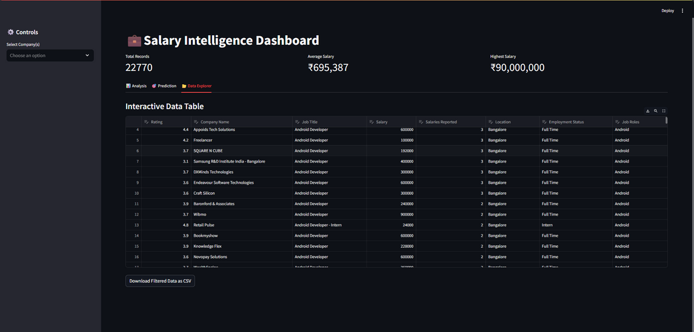
SCREENSHOTS

Slide 7
THANK YOU!

